Slide 1
Panel Discussion Topic
DESIGN UNDER UNCERTAINTY from variability to model-form uncertainty and design validation
Nozomu KOGISO
Department of Aerospace Engineering
Osaka Prefecture University, Japan
State-of-the-Art (SOTA) Panel Discussion, WCSMO-11
7-12, June, 2015, Sydney, Australia

Slide 2
Acknowledgement
I express my thanks to Prof. Shinji Nishiwaki and Prof. Kazuhiro Izui in Kyoto University, Japan for valuable comments and suggestions.

Slide 3
Contents
Background
  Recent history about “Optimization under Uncertainty”
  Problems for “Optimization under Uncertainty”
WCSMO-11 Statistics
  Physical (aleatory) Uncertainty
  Information (epistemic) Uncertainty
For next step
  “Optimization under Uncertainty”

Slide 4
Some Aspects on Optimization
Topology optimization introduces the optimization method to conceptual design stage and to many engineering fields.
Evolutional or stochastic methods make it possible to solve difficult problems such as NP-hard, multimodal, or combinatorial problems.
New Paradigm
New Optimization Algorithms
Approximation by surrogates or meta-models makes it possible to solve a large-scale optimization design problem.
Real design problem in many engineering field such as architecture, mechanical, automotive, civil, aerospace and marine engineering, composite and nano-materials, .....
Computationally Efficient Method
Applications

Slide 5
Short History of RBDO
Reliability-Based Design Optimization
1995
2000
2005
2010
2015
WCSMO-1
PMA
WCSMO-11
FORM
‘78
Improve
convergence
Topology Opt. w Uncertainty
Double-loop app.
SORA
Physical uncertainty
SLSV
Decoupled
Single-loop
app.
Integration
Accurate reliability analysis
Development of computational statistics
Lack of information
Uncertainty quantification
Uncertainty propagation
ASME V&V

Slide 6
Flow in my understanding
Everybody knows the importance of considering uncertainty
BUT, not satisfied with RBDO result.
  No easy-to-follow results like “Mitchell Truss”
  Not clear how reliable the RBDO result is?
  Not clear how to determine the input uncertain values?
Epistemic uncertainty
Integration
To make valuable
design target
design process
  Accurate Estimation of
    Random parameter itself
    Confidence region
    Bayesian Updating
Notes:
It is difficult for engineer to make a decision using RBDO results. It means engineer does not understand how reliable the result is.
It is very irony situation.
Then, the researcher struggle the problem using mathematics, probabilistic and statistics.
IT shows the accurate estimation of the random parameter itself. In addition, the parameter itself has uncertainty.
So, the confidence level is estimated with high accuracy.
Now, the approach is almost successful, as many presentations
But still connecting to design process is not yet established.

Slide 7










Graphical example
$$f\left(x\right)$$
Epistemic uncertainty
$$x_{2}$$
Feasible region
$$g_{1}=0$$
RBDO
Deterministic optimum
$$x^{∗}$$
$$g_{2}=0$$
$$x_{2}$$
$$x_{1}$$
Confidence interval of RBDO
$$g_{1}=0$$
If variation of input variable has epistemic uncertainty, the optimum result also has uncertainty.
Likelihood of RBDO will be described by using “confidence interval” or some statistical index.
$$g_{2}=0$$
$$x_{1}$$

Slide 8
Design with Uncertainty
Two aspects
Aleatory uncertainty
Epistemic uncertainty
Physical uncertainty
Lack of information
Model uncertainty
To minimize effect on performance
Reliability-based design
Robust design
To identify error sources for minimizing unknown uncertainty
Uncertainty quantification
Uncertainty propagation
Valuable for design target
Valuable for design process
Notes:
Even if uncertain parameter is estimated accurately, the performance of design target will not be improved.
But the decision making process will be improved.

Slide 9
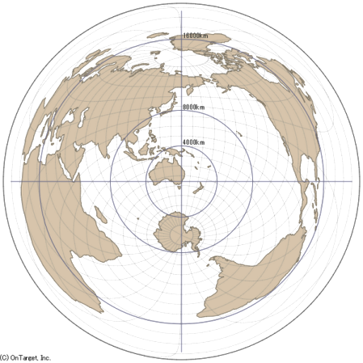
WCSMO-11 Statistics
Uncertainty related papers 42 / 343 ~ 13 %
Sessions | # | # papers
Design with uncertainty | 3 | 14
Robust and Reliability-based Design Optimization | 3 | 15
Topology and Shape Optimization (Robustness) | 1 | 4
In other sessions (Papers related to uncertainty) |  | 9
Countries
  Asia 29 (China 10, Korea 12, Japan 5, India 1, Taiwan 1)
  Australia 4
  United States 6
  Europe 3 (France 2, Sweden 1)
Notes:
Cancel Japan 1 (Monday)

Slide 10
Related Topics 1/2
Physical Uncertainty (aleatory)
  Robust Topology Optimization
    Uncertainty in load condition, geometry, material property
  Application (in almost cases, surrogate model is used such as Kriging, SVM, ANN)
    Medical eng., automotive struct., sounding rocket, small satellite, electronic device (Battery, LCD), offshore and deep-sea struct., photonic struct., Pyrotechnical device, SMA, Welded structure
Efficient Method and applications
    eSORM (Enhanced second-order reliability method)
    SOMUA (Sequential optimization and mixed uncertainty analysis)
    EGTRA (Ensemble of gradient-based transformed reliability analyses)
Notes:
Model calibration

Slide 11
Related Topics 2/2
Lack of information (epistemic)
  Accurate uncertain parameter estimation, model calibration, FE model updating, Data updating from experiment and operation
  Estimate confidence level of uncertain parameter from small data
    Confidence bounds, Model calibration, Probability interval
    Computational Statistic Methods (Bayesian Updating, MCMC, Akaike information criteria )
    Evidence theory, Parameter Updating
  Application
    Consider both epistemic and aleatory uncertainties.
Notes:
Model calibration

Slide 12
Key
“Optimum design with uncertainty” for accountability of designed system
What kind of design problems should be formulated along with design process ?
How accurate uncertainty estimation is required along with design process?
Conceptual
Primary
Detail
Uncertainty
Optimization
Physics
epistemic (information)
uncertainty
Aleatory (physical)
uncertainty

Slide 13
Future problems
Integration of physical and uncertainty analyses to estimate performance uncertainty (uncertainty propagation) accurately and efficiently
  As higher accuracy is required for the physical analysis, uncertainty parameter must estimate with higher accuracy.
  Integration of physics and uncertainty. (e.g. redundancy analysis)
  Computational efficient method (even if sensitivity is approximated by FDM)
Parameter updating using experiment or even in-service
  Application of big data analysis to optimization process
Trade-off analysis to Identify effects of uncertain parameter accuracy on the optimization results
  Integration of multiobjective optimization to show “trade-off”
  WHAT kind of effects and HOW large effects the optimum design has.

Slide 14
References
Yao, W., et al.: Review of Uncertainty-Based Multidisciplinary Design Optimization Methods for Aerospace Vehicles, Progress in Aerospace Sciences, 47 (2011), 450-479.
  With 366 references
Sankararaman, S. and Mahadevan, S.: Model Validation under Epistemic Uncertainty, Reliability Engineering and System Safety, 96 (2011), 1232-1241.
Roy, C. J., and Oberkampf, W. L.: A Comprehensive Framework for Verification, Validation, and Uncertainty, Computer Methods in Applied Mechanics and Engineering, 200 (2011), 2131-2144.

Slide 15
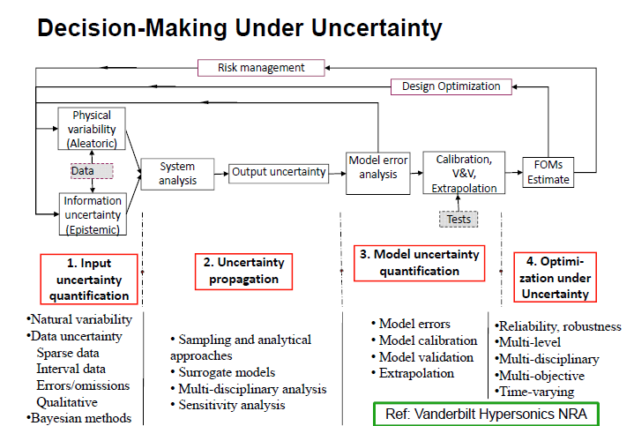
Prof. S. Mahadevan (Vanderbilt University), Reliability/Robust Based Design Optimization, Panel Session, WCSMO9, 2011

